Slide 1
Chapter 9
Disk Storage and Indexing Structures for Files
Copyright © 2004 Pearson Education, Inc.

Slide 2
Outline
Disk Storage Devices
Files of Records
Indexing Structures for Files
Slide 9 -<number>

Slide 3
Disk Storage Devices (cont.)
Preferred secondary storage device for high storage capacity and low cost.
Data stored as magnetized areas on magnetic disk surfaces.
A disk pack contains several magnetic disks connected to a rotating spindle.
Disks are divided into concentric circular tracks on each disk surface. Track capacities vary typically from 4 to 50 Kbytes.
Slide 9 -<number>

Slide 4
Disk Storage Devices (cont.)
Because a track usually contains a large amount of information, it is divided into smaller blocks or sectors.
The division of a track into sectors is hard-coded on the disk surface and cannot be changed. One type of sector organization calls a portion of a track that subtends a fixed angle at the center as a sector.
A track is divided into blocks. The block size B is fixed for each system. Typical block sizes range from B=512 bytes to B=4096 bytes. Whole blocks are transferred between disk and main memory for processing.
Slide 9 -<number>

Slide 5
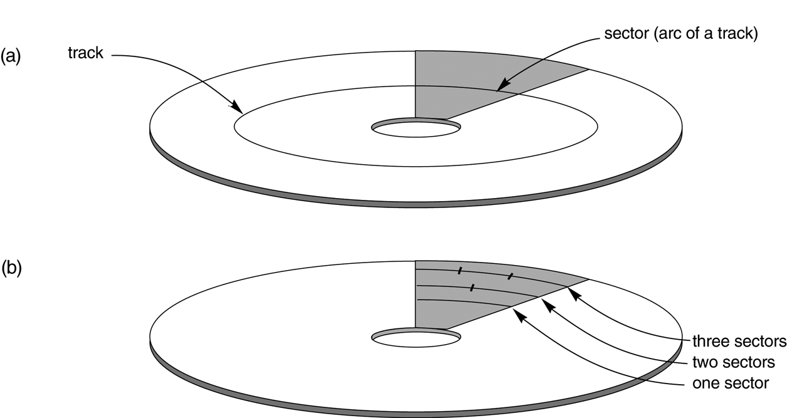
Disk Storage Devices (cont.)
Slide 9 -<number>

Slide 6
Disk Storage Devices (cont.)
A read-write head moves to the track that contains the block to be transferred. Disk rotation moves the block under the read-write head for reading or writing.
A physical disk block (hardware) address consists of a cylinder number (imaginery collection of tracks of same radius from all recoreded surfaces), the track number or surface number (within the cylinder), and block number (within track).
Reading or writing a disk block is time consuming because of the seek time s and rotational delay (latency) rd.
Double buffering can be used to speed up the transfer of contiguous disk blocks.
Slide 9 -<number>

Slide 7
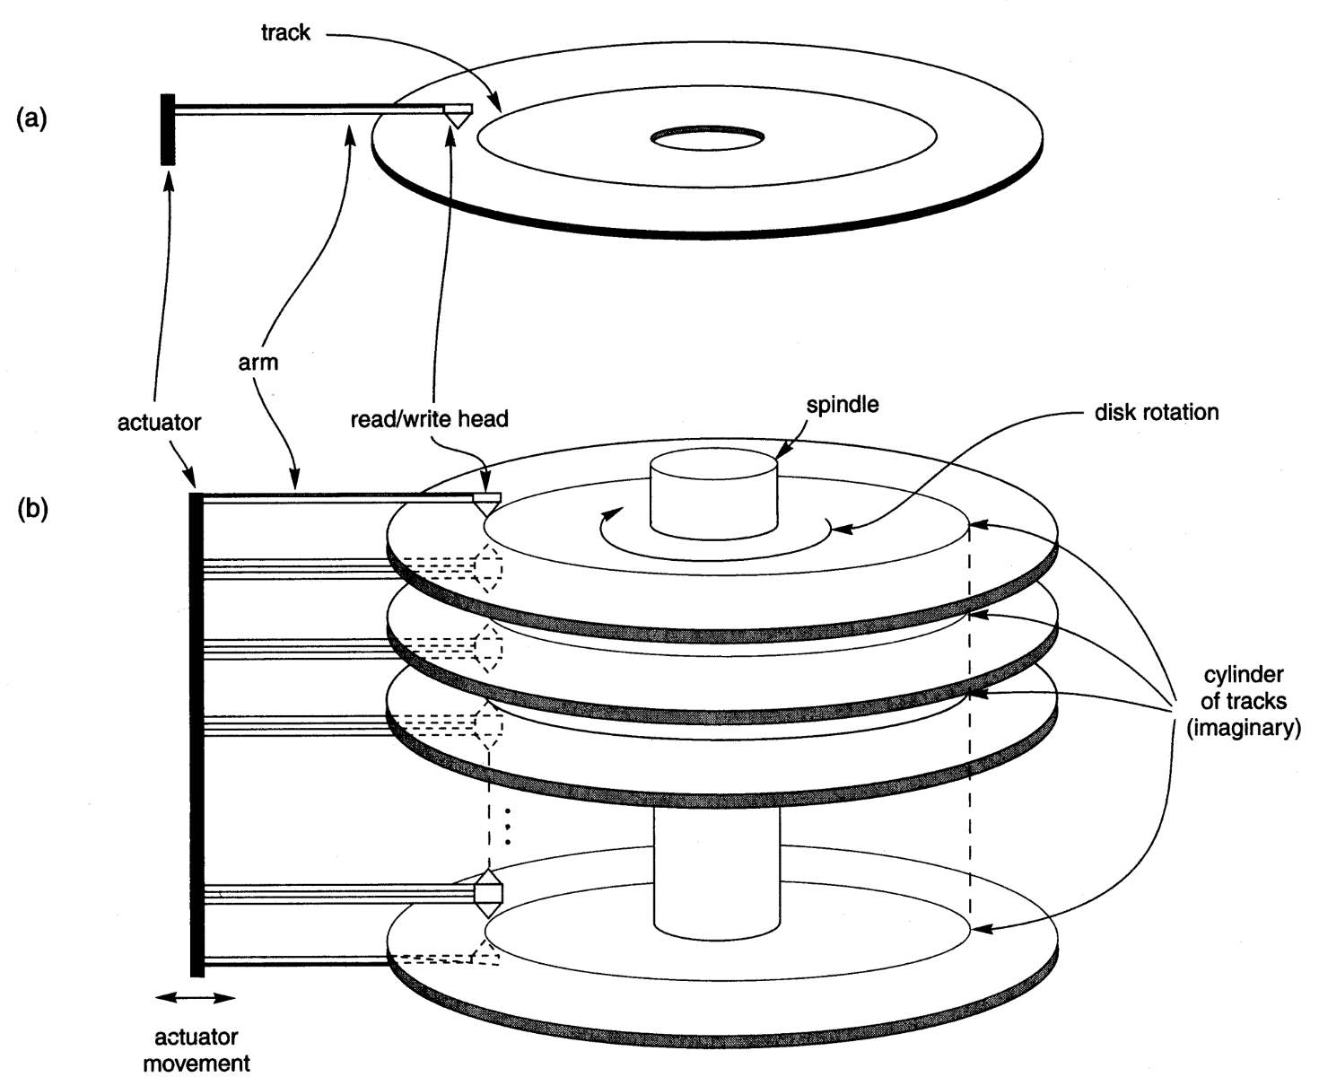
Disk Storage Devices (cont.)
Slide 9 -<number>

Slide 8
Records
Fixed and variable length records
Records contain fields which have values of a particular type (e.g., amount, date, time, age)
Fields themselves may be fixed length or variable length
Variable length fields can be mixed into one record: separator characters or length fields are needed so that the record can be “parsed”.
Slide 9 -<number>

Slide 9
16.4 Placing File Records on Disk
Record: collection of related data values or items
  Values correspond to record field
Data types
  Numeric
  String
  Boolean
  Date/time
Binary large objects (BLOBs)
  Unstructured objects
Slide 16- <number>

Slide 10
Blocking
Blocking: refers to storing a number of records in one blo ck on the disk.
Blocking factor (bfr) refers to the number of records per block.
There may be empty space in a block if an integral number of records do not fit in one block.
Spanned Records: refer to records that exceed the size of one or more blocks and hence span a number of blocks.
Slide 9 -<number>

Slide 11
Files of Records
A file is a sequence of records, where each record is a collection of data values (or data items).
A file descriptor (or file header ) includes information that describes the file, such as the field names and their data types, and the addresses of the file blocks on disk.
Records are stored on disk blocks. The blocking factor bfr for a file is the (average) number of file records stored in a disk block.
A file can have fixed-length records or variable-length records.
Slide 9 -<number>

Slide 12
Files of Records (cont.)
File records can be unspanned (no record can span two blocks) or spanned (a record can be stored in more than one block).
The physical disk blocks that are allocated to hold the records of a file can be contiguous, linked, or indexed.
In a file of fixed-length records, all records have the same format. Usually, unspanned blocking is used with such files.
Files of variable-length records require additional information to be stored in each record, such as separator characters and field types. Usually spanned blocking is used with such files.
Slide 9 -<number>

Slide 13
Placing File Records on Disk (cont’d.)
Reasons for variable-length records
  One or more fields have variable length
  One or more fields are repeating
  One or more fields are optional
  File contains records of different types
Slide 16- <number>

Slide 14
Record Blocking and Spanned Versus Unspanned Records
File records allocated to disk blocks
Spanned records
  Larger than a single block
  Pointer at end of first block points to block containing remainder of record
Unspanned
  Records not allowed to cross block boundaries
Slide 16- <number>

Slide 15
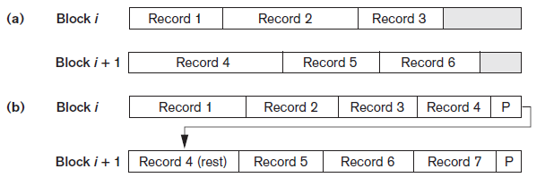
Record Blocking and Spanned Versus Unspanned Records (cont’d.)
Blocking factor
  Average number of records per block for the file
Figure 16.6 Types of record organization (a) Unspanned (b) Spanned
Slide 16-<number>

Slide 16
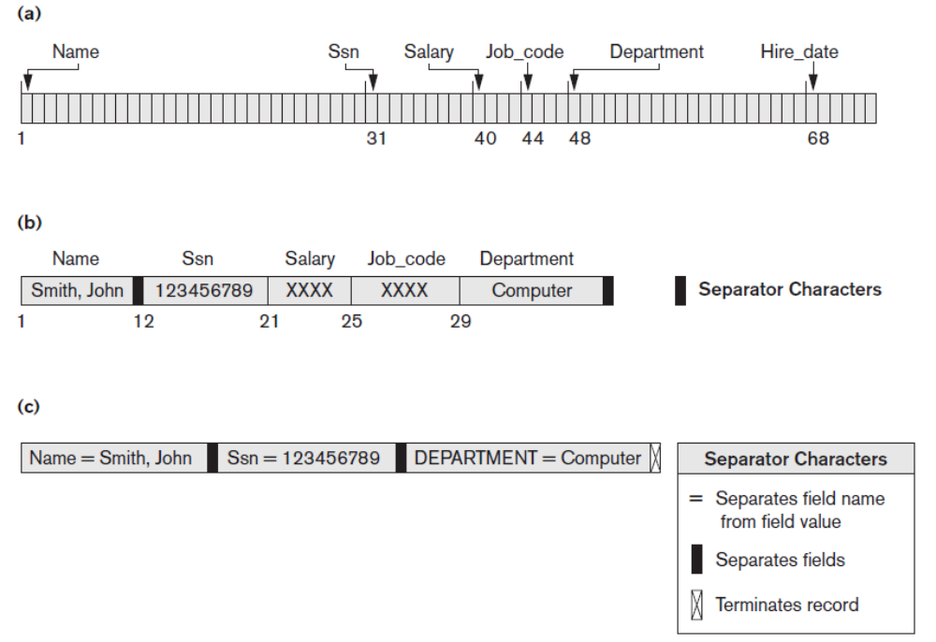
Slide 8- <number>

Slide 17
Record Blocking and Spanned Versus Unspanned Records (cont’d.)
Allocating file blocks on disk
  Contiguous allocation
  Linked allocation
  Indexed allocation
File header (file descriptor)
  Contains file information needed by system programs
    Disk addresses
    Format descriptions
Slide 16- <number>

Slide 18
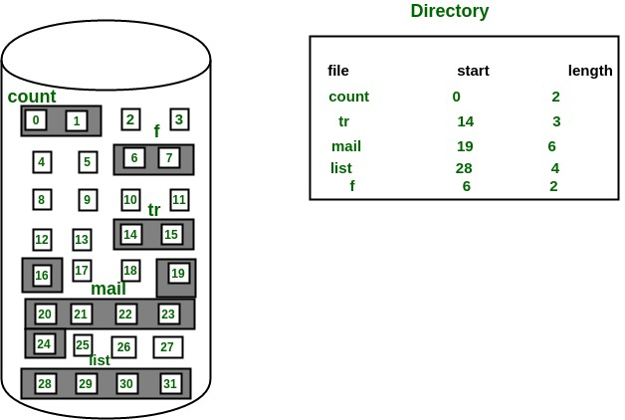
Contiguous Allocation
Slide 16- <number>

Slide 19
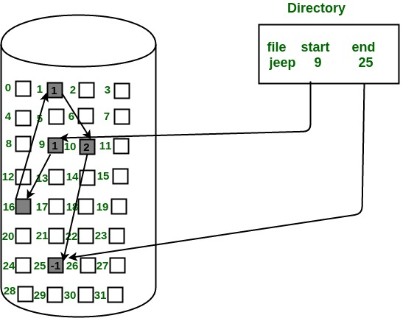
Linked Allocation
Slide 16- <number>

Slide 20
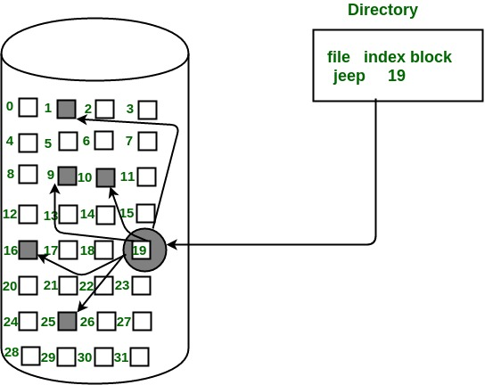
Indexed Allocation
Slide 16- <number>

Slide 21
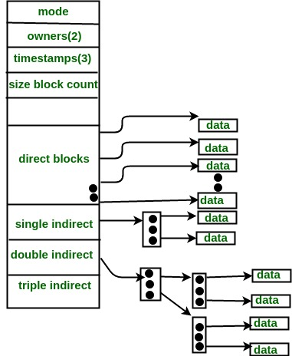
I-Node
Slide 16- <number>

Slide 22
Buffer Management and Replacement Strategies
Buffer management information
  Pin count
  Dirty bit
Buffer replacement strategies
  Least recently used (LRU)
  Clock policy
  First-in-first-out (FIFO)
  MRU
Slide 16- <number>

Slide 23
Buffer Management and Replacement Strategies
Buffer replacement strategies
  Policies like FIFO can be modified to make sure that pinned blocks, such as root block of an index, are allowed to remain in the buffer
  Modification of the clock policy exists where important buffers flag can be set to higher values than 1
  DBMS has the ability to write certain blocks to disk even when the space occupied by those blocks is not needed
  MRU work well when a block that is used most recently is not needed until all the remaining blocks in the relation are processed
Slide 16- <number>

Slide 24
Indexing Structures for Files
Types of Single-level Ordered Indexes
  Primary Indexes
  Clustering Indexes
  Secondary Indexes
Multilevel Indexes
Dynamic Multilevel Indexes Using B-Trees and B+-Trees
Indexes on Multiple Keys
Slide 9 -<number>

Slide 25
Indexes as Access Paths
A single-level index is an auxiliary file that makes it more efficient to search for a record in the data file.
The index is usually specified on one field of the file (although it could be specified on several fields)
One form of an index is a file of entries <field value, pointer to record>, which is ordered by field value
The index is called an access path on the field.
Slide 9 -<number>

Slide 26
Indexes as Access Paths (contd.)
The index file usually occupies considerably less disk blocks than the data file because its entries are much smaller
A binary search on the index yields a pointer to the file record
Indexes can also be characterized as dense or sparse.
    A dense index has an index entry for every search key value (and hence every record) in the data file.
    A sparse (or nondense) index, on the other hand, has index entries for only some of the search values
Slide 9 -<number>

Slide 27
Indexes as Access Paths (contd.)
Example: Given the following data file:
EMPLOYEE(NAME, SSN, ADDRESS, JOB, SAL, ... )
Suppose that:
record size R=150 bytes
block size B=512 bytes
r=30000 records
Then, we get:
blocking factor Bfr= B div R= 512 div 150= 3 records/block
number of file blocks b= (r/Bfr)= (30000/3)= 10000 blocks
For an index on the SSN field, assume the field size V_{SSN}=9 bytes,
assume the record pointer size P_{R}=7 bytes. Then:
index entry size R_{I}=(V_{SSN}+ P_{R})=(9+7)=16 bytes
index blocking factor Bfr_{I}= B div R_{I}= 512 div 16= 32 entries/block
number of index blocks b= (r/ Bfr_{I})= (30000/32)= 938 blocks
binary search needs log₂bI= log₂938= 10 block accesses
This is compared to an average linear search cost of:
(b/2)= 30000/2= 15000 block accesses
If the file records are ordered, the binary search cost would be:
log₂b= log₂30000= 15 block accesses
Slide 9 -<number>

Slide 28
Types of Single-Level Indexes
Primary Index
  Defined on an ordered data file
  The data file is ordered on a key field
  Includes one index entry for each block in the data file; the index entry has the key field value for the first record in the block, which is called the block anchor
  A similar scheme can use the last record in a block.
  A primary index is a nondense (sparse) index, since it includes an entry for each disk block of the data file and the keys of its anchor record rather than for every search value.
Slide 9 -<number>

Slide 29
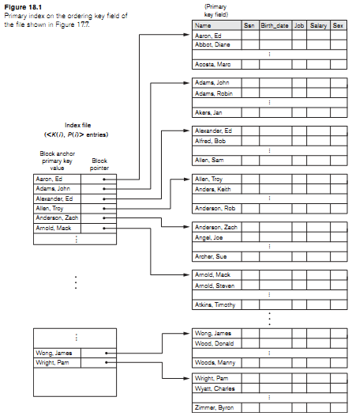
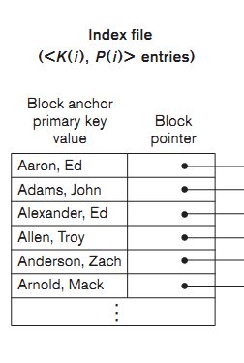
Slide 9 -<number>

Slide 30
Types of Single-Level Indexes
Clustering Index
  Defined on an ordered data file
  The data file is ordered on a non-key field unlike primary index, which requires that the ordering field of the data file have a distinct value for each record.
  Includes one index entry for each distinct value of the field; the index entry points to the first data block that contains records with that field value.
  It is another example of nondense index where Insertion and Deletion is relatively straightforward with a clustering index.
Slide 9 -<number>

Slide 31
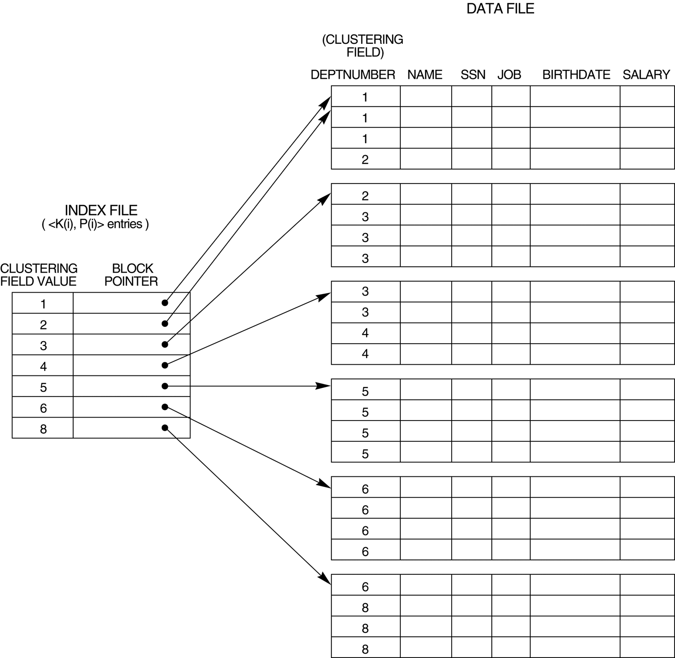
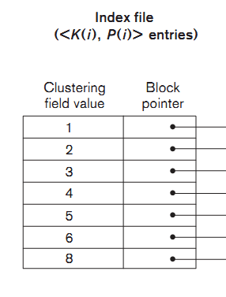
Slide 9 -<number>

Slide 32
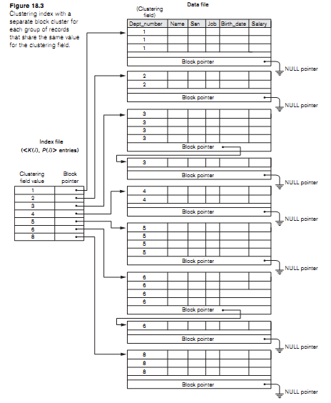
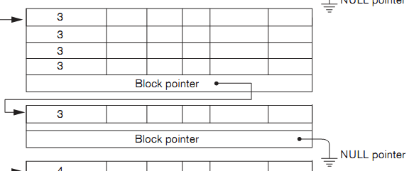
Slide 9 -<number>

Slide 33
Types of Single-Level Indexes
Secondary Index
  A secondary index provides a secondary means of accessing a file for which some primary access already exists.
  The secondary index may be on a field which is a candidate key and has a unique value in every record, or a nonkey with duplicate values.
  The index is an ordered file with two fields.
    The first field is of the same data type as some nonordering field of the data file that is an indexing field.
    The second field is either a block pointer or a record pointer. There can be many secondary indexes (and hence, indexing fields) for the same file.
  Includes one entry for each record in the data file; hence, it is a dense index
Slide 9 -<number>

Slide 34
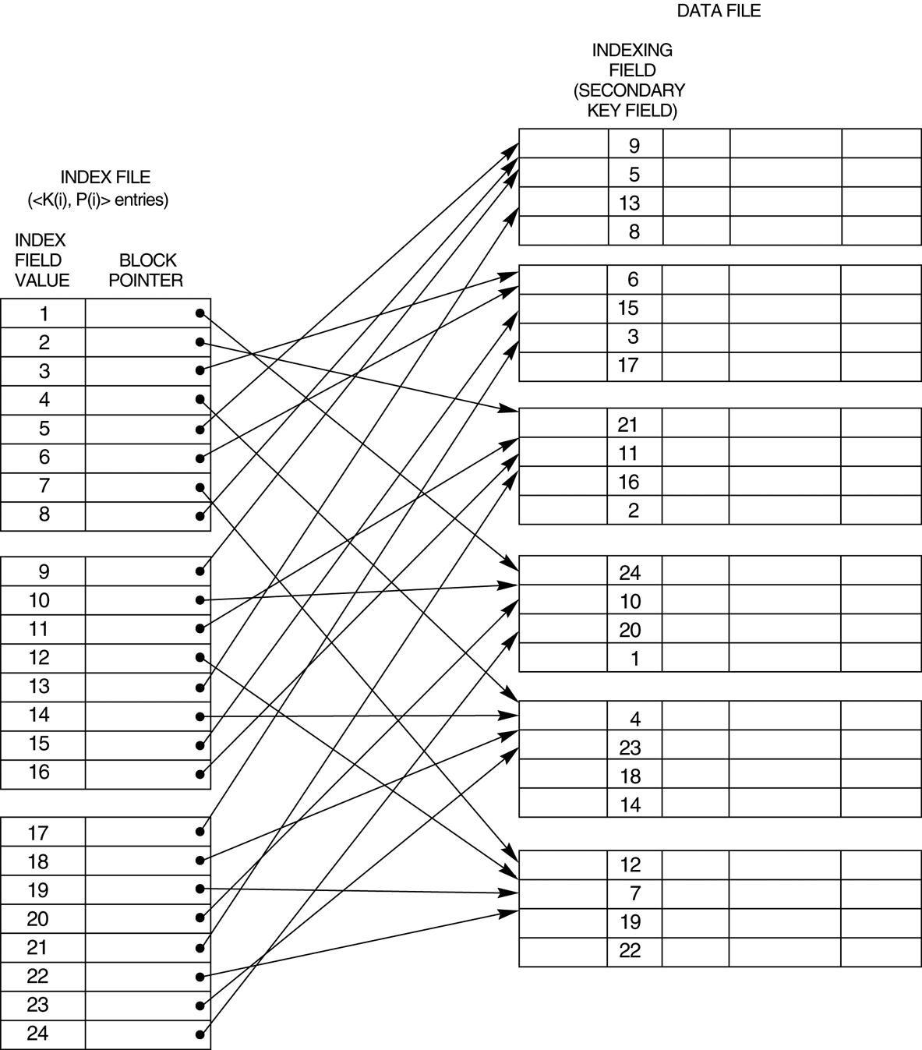
A dense secondary index (with block pointers) on a nonordering key field of a file.
Slide 9 -<number>

Slide 35
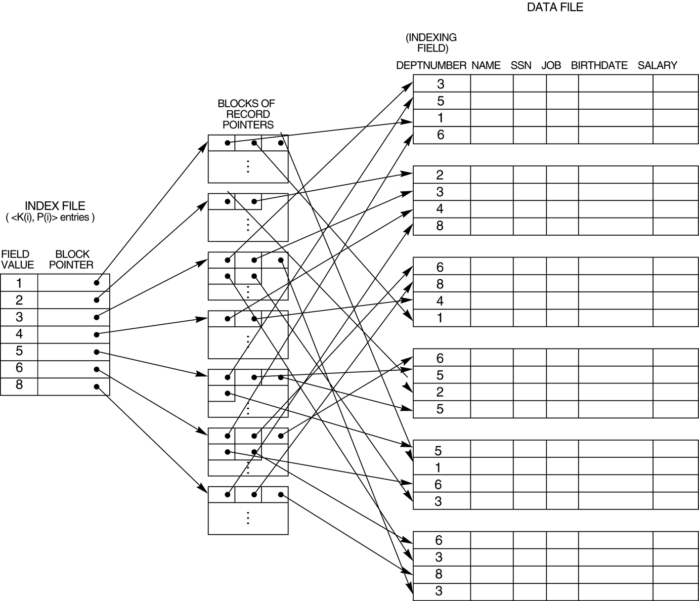
A secondary index (with recored pointers) on a nonkey field implemented using one level of indirection so that index entries are of fixed length and have unique field values.
Slide 9 -<number>

Slide 36
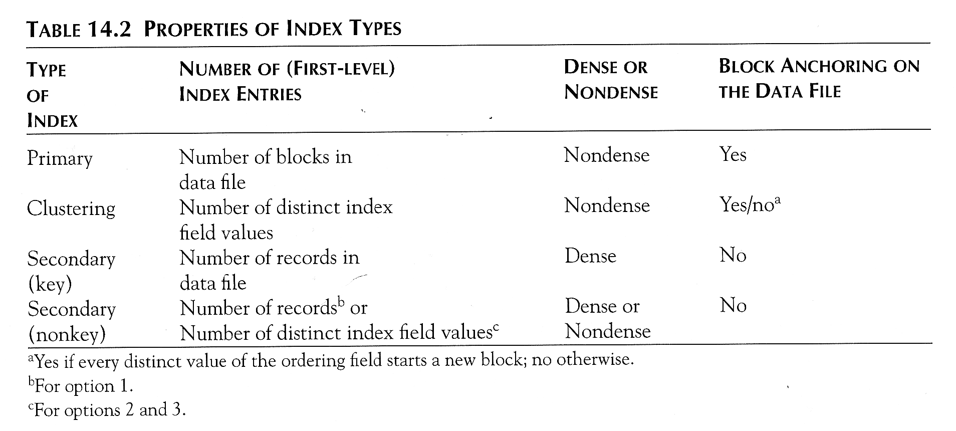
Slide 9 -<number>

Slide 37
Multi-Level Indexes
Because a single-level index is an ordered file, we can create a primary index to the index itself ; in this case, the original index file is called the first-level index and the index to the index is called the second-level index.
We can repeat the process, creating a third, fourth, ..., top level until all entries of the top level fit in one disk block
A multi-level index can be created for any type of first-level index (primary, secondary, clustering) as long as the first-level index consists of more than one disk block
Slide 9 -<number>

Slide 38
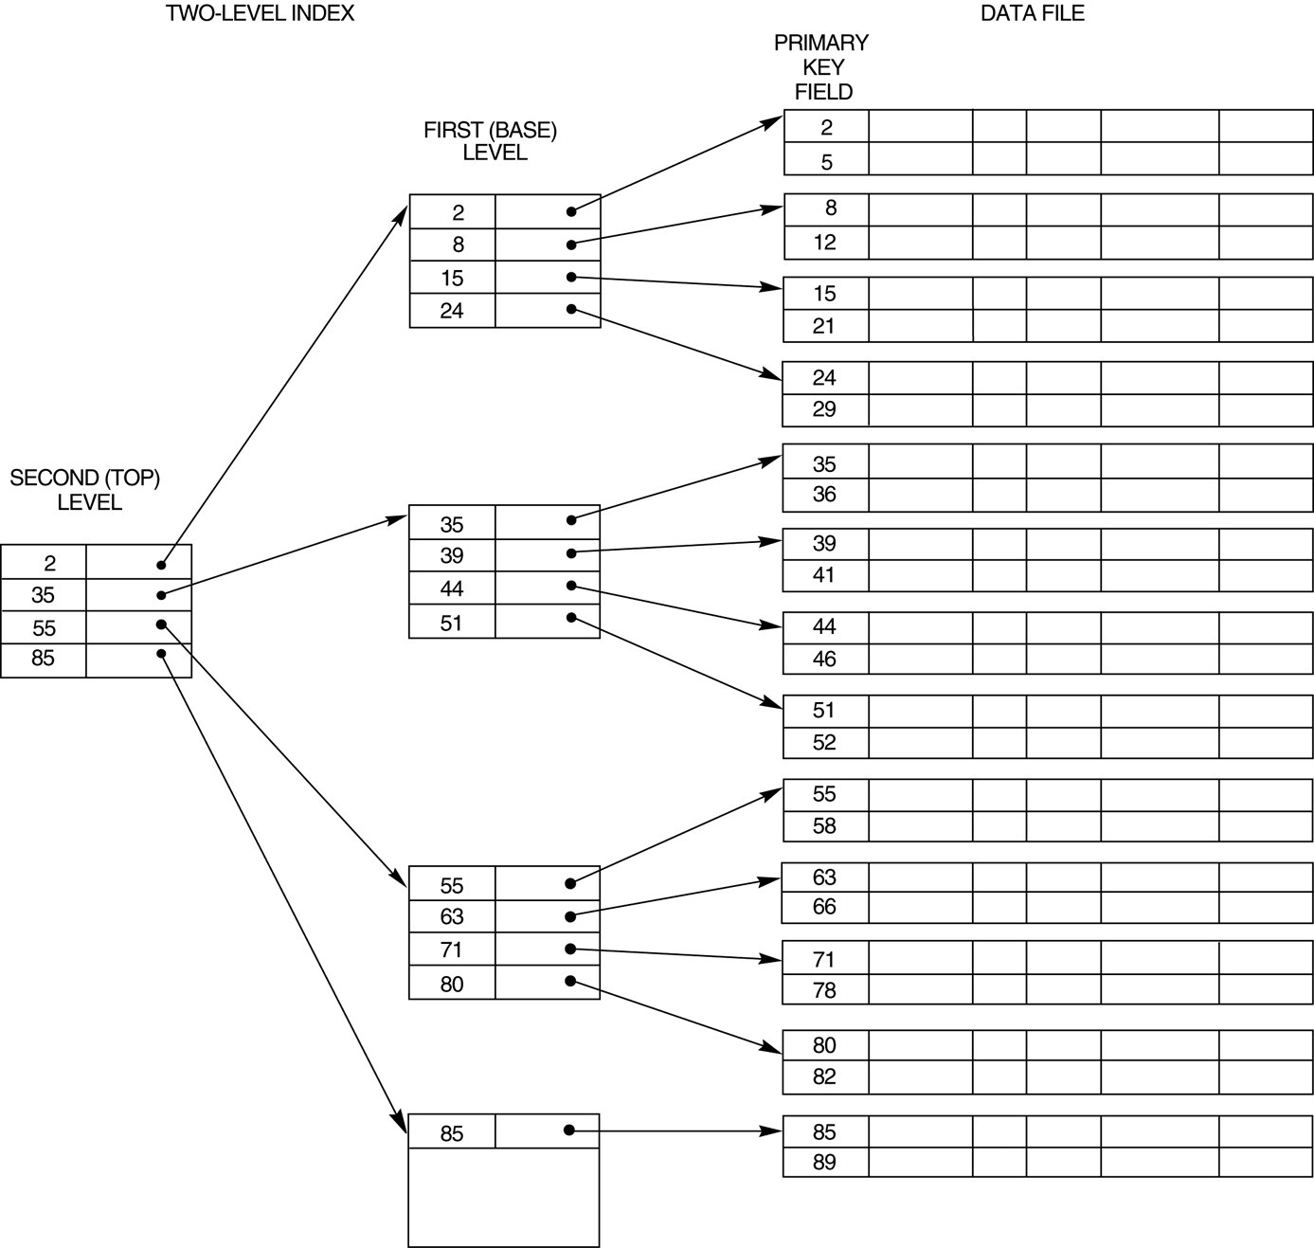
A two-level primary index resembling ISAM (Indexed Sequential Access Method) organization
Slide 9 -<number>

Slide 39
Dynamic Multi-Level Indexes
To retain the benefits of using multilevel indexing while reducing index insertion and deletion problems
Leaves some space in each of its blocks for inserting new entries and uses appropriate insertion/deletion algorithms for creating and deleting new index blocks when the data file grows and shrinks.
Often implemented by using data structures called B-trees and B+-trees
Slide 9 -<number>

Slide 40
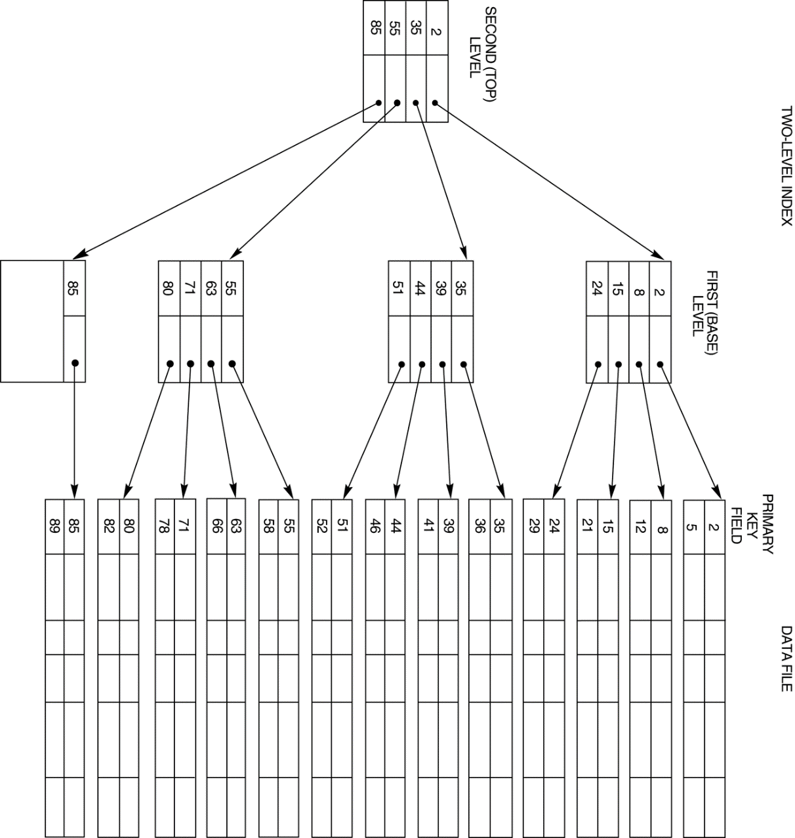
Multi-Level Indexes
Slide 9 -<number>

Slide 41
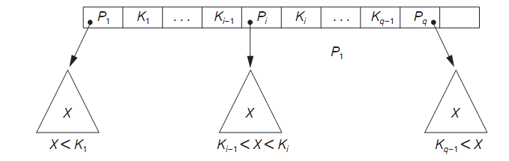
Search Tree
A search tree of order p is a tree such that each node contains at most p − 1 search values and p pointers in the order <P1, K1, P2, K2, ..., Pq−1, Kq−1, Pq>, where q ≤ p. Each Pi is a pointer to a child node (or a NULL pointer), and each Ki is a search value from some ordered set of values. All search values are assumed to be unique
Slide 9 -<number>

Slide 42
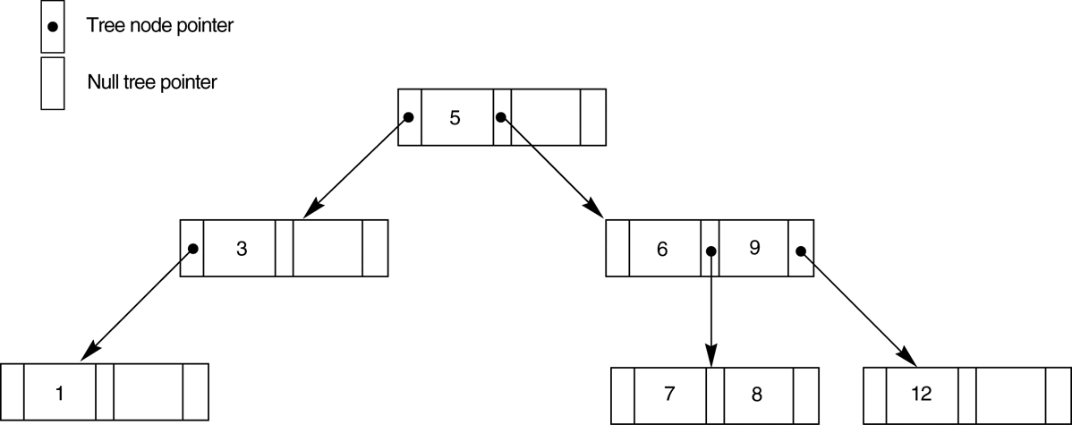
A search tree of order p = 3.
Slide 9 -<number>

Slide 43
Dynamic Multilevel Indexes Using B-Trees and B+-Trees
Because of the insertion and deletion problem, most multi-level indexes use B-tree or B+-tree data structures, which leave space in each tree node (disk block) to allow for new index entries
These data structures are variations of search trees that allow efficient insertion and deletion of new search values.
In B-Tree and B+-Tree data structures, each node corresponds to a disk block
Each node is kept between half-full and completely full
Slide 9 -<number>

Slide 44
Dynamic Multilevel Indexes Using B-Trees and B+-Trees (contd.)
An insertion into a node that is not full is quite efficient; if a node is full the insertion causes a split into two nodes
Splitting may propagate to other tree levels
A deletion is quite efficient if a node does not become less than half full
If a deletion causes a node to become less than half full, it must be merged with neighboring nodes
Slide 9 -<number>

Slide 45
Difference between B-tree and B+-tree
In a B-tree, pointers to data records exist at all levels of the tree
In a B+-tree, all pointers to data records exists at the leaf-level nodes
A B+-tree can have less levels (or higher capacity of search values) than the corresponding B-tree
Slide 9 -<number>

Slide 46
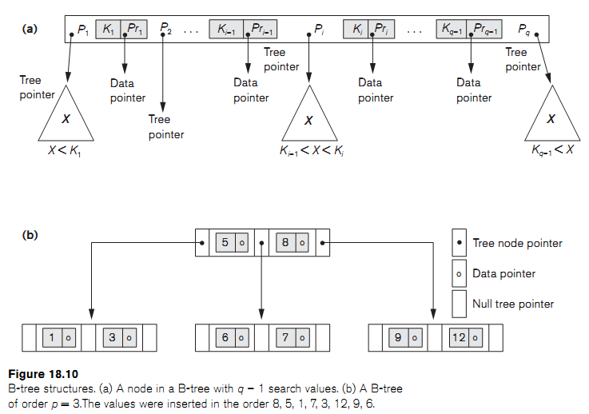
Slide 9 -<number>

Slide 47
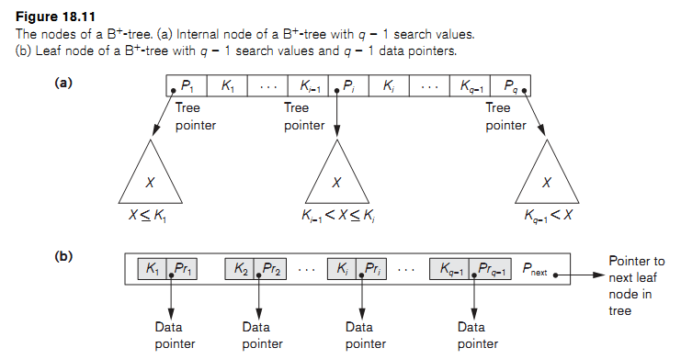
Slide 9 -<number>

Slide 48
Indexes on Multiple Keys
Ordered Index on Multiple Attributes
  Create a index on a search key field that is a combination of multiple attributes
  A lexicographic ordering of these tuple values establishes an order on this composite search key
Partitioned Hashing
  For a key consisting of n components, the hash function is designed to produce a result with n separate hash addresses
Grid Files
  Construct a grid array with one linear scale (or dimension) for each of the search attributes
Slide 9 -<number>

Slide 49
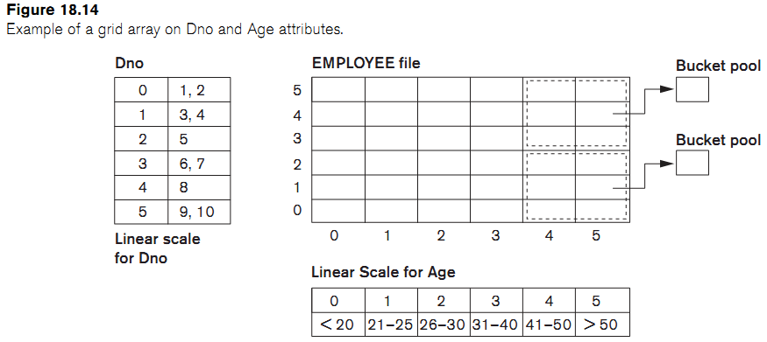
Slide 9 -<number>

Slide 50
Other Types of Indexes
Hash Indexes
Bitmap Indexes
Function based Indexing
Slide 9 -<number>

